Slide 1

Automation of Invoice Reporting with UiPath
Joseph Boring
AI Automation | Project 6

Slide 2
Problem
The finance team's manual invoice tracking process was a significant operational bottleneck. This time-consuming, repetitive task was prone to data entry errors, leading to a risk of late payments and a lack of real-time visibility into upcoming financial liabilities. The process diverted skilled team members from high-value analysis to low-value clerical work.

Slide 3
Solution
I designed and deployed an intelligent automation solution using UiPath to streamline the entire invoice reporting workflow. The RPA bot ingests all invoices, leverages Document Understanding to extract key data points, applies business logic to filter them by due date, and uses GenAI to create concise, human-readable purchase summaries. The final, validated data is written to a centralized Google Sheet, creating an accurate, on-demand report.

Slide 4
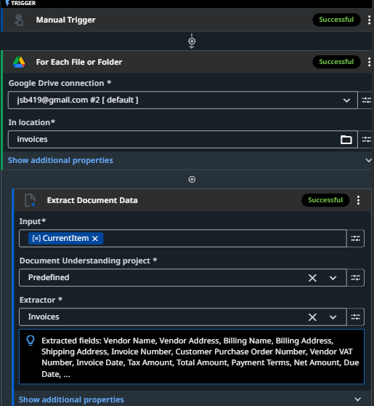
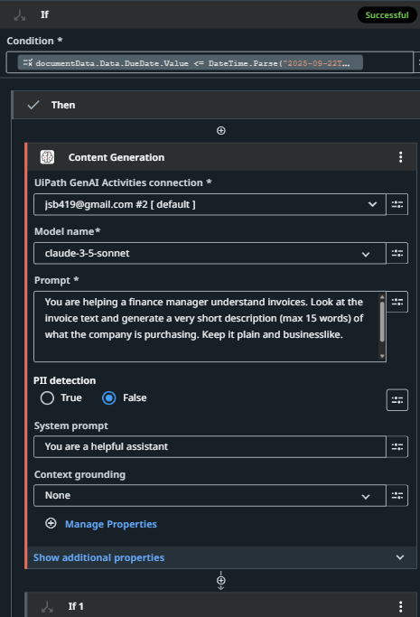
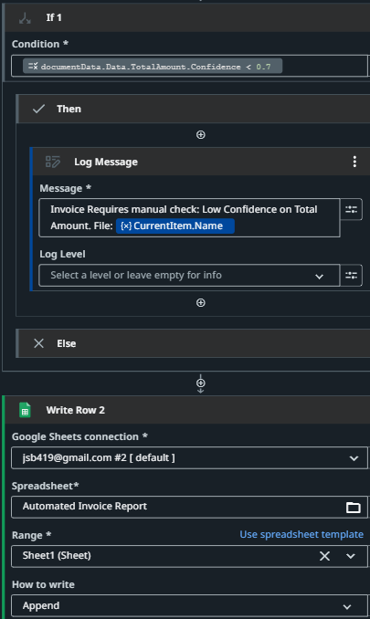
RPA workflow diagram 1/2
Cont’d Next Slide

Slide 5
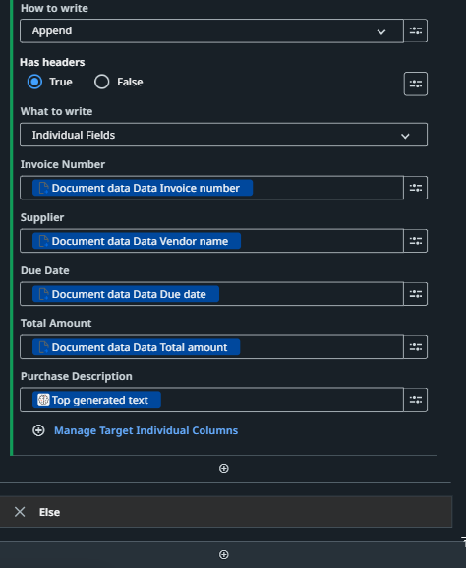
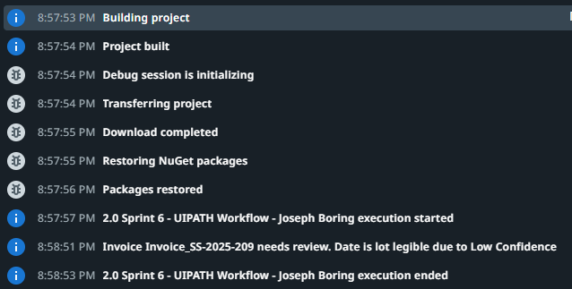
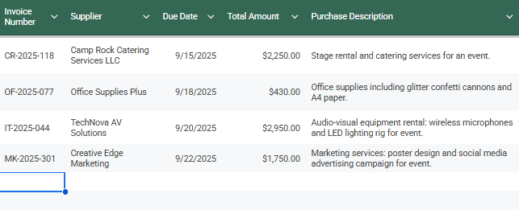
RPA workflow diagram 2/2 + Results
**Link to Adjustment**

Slide 6
Benefits
Increased Efficiency & ROI: Eliminates hours of manual data entry, freeing the finance team to focus on strategic financial analysis rather than clerical tasks.
Enhanced Data Accuracy: Drastically reduces the risk of human error in data transfer, leading to more reliable and trustworthy financial reporting.
Accelerated Decision-Making: Provides managers with an instant, easy-to-understand report, complete with AI-generated context, enabling faster payment approvals.
Proactive Risk Management: The automated confidence check flags potentially erroneous data for immediate human review, preventing costly mistakes before they happen.

Slide 7
Challenges & improvements
Challenges: While effective, this solution's primary challenge in a scaled environment would be the high variability of invoice formats from different vendors. This necessitates robust error handling and highlights an opportunity for training a custom document extraction model.
Future Improvements: This workflow is a powerful foundation. The next iteration could include direct API integration with accounting software to eliminate the spreadsheet, automated email summaries for managers, and a dashboard for visualizing payment trends.

Slide 8
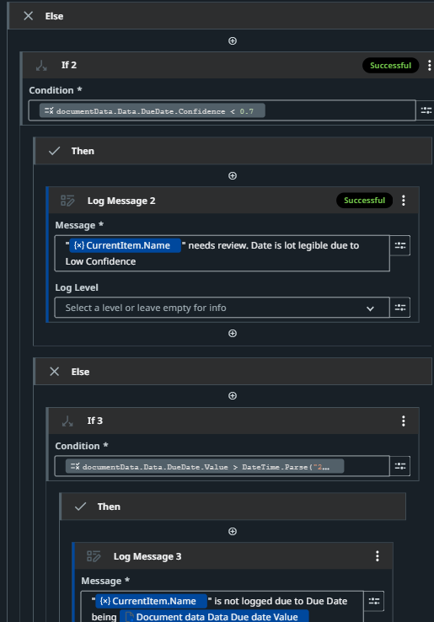
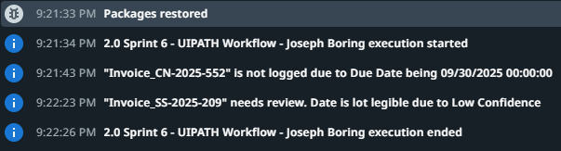
Per Project Feedback:
Added an “Else” statement.
Why?
The loop only logged documents with a due date of <= 9/22.
Therefore, the legibility of a document voided Invoice XX-209.pdf from even being flagged.

